Slide 1
IPL Data Analysis

Slide 2
Introduction
The Indian Premier League (IPL) is a professional Twenty20 cricket league in India, widely regarded as one of the most popular and lucrative cricket tournaments globally. The IPL was founded by the Board of Control for Cricket in India (BCCI) and launched in 2008. Since its inception, the league has revolutionized cricket with its fast-paced format, high entertainment value, and massive fan following worldwide.
In this presentation I will try to publish the insights obtained by analyzing the data of its first 9 seasons.

Slide 3
Problem Statement
RCB team is looking for top-performing and reliable players to win tournaments, considering both on-field performance and value for money in mega player auction of 2017.
So we have to come up with strategies/suggestions regarding selecting the best-performing players and optimizing player auction investments.

Slide 4
Objective of the Project
The aim of the project is to come up with strategies/suggestions regarding selecting the best-performing players and optimizing player auction investments, considering both on-field performance and value for money in mega player auction of 2017.

Slide 5
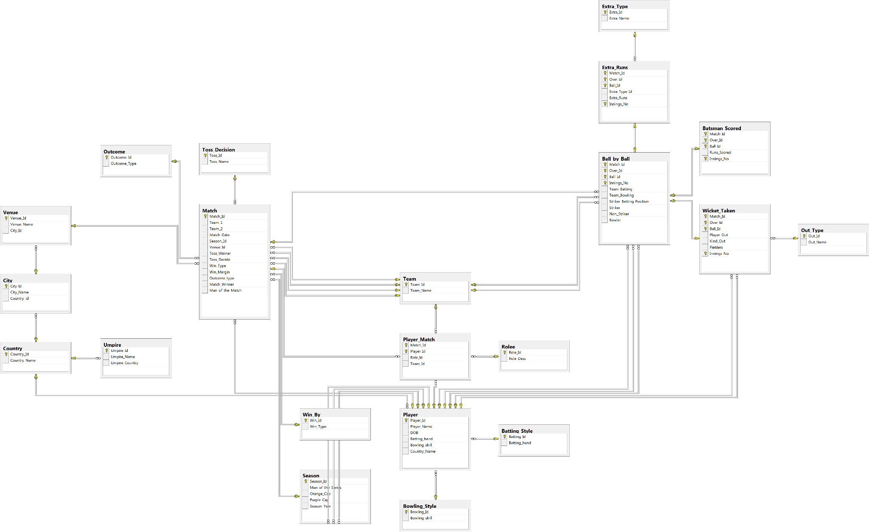
Database Schema
Here you have a list of items
And some text
But remember not to overload your slides with content
Your audience will listen to you or read the content, but won’t do both.

Slide 6
Data Overview
The data consists of 22 tables.
The major useful tables are ball_by_ball , matches , player, batsman_scored , wicket_taken and player_match.
The sql file that contained data had almost close to 3 lakh rows.

Slide 7
Analysis & Insights
Total runs scored by rcb in season 1 including extra runs are 1983 and rcb finished 7 in that season.
RCB took only 66 wickets in 1st season which is their lowest among all seasons.
RCB won only 4 matches in season 1 .
There were 79 players in season 2 who were above the age of 25 at that time.

Slide 8
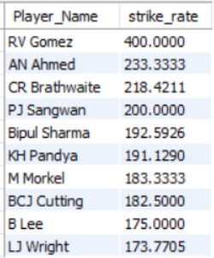
Analysis & Insights
Now we will see the top 10 players with best strike rate in last 4 seasons.

Slide 9


Analysis & Insights
Now we will see 2 KPIs to analyse RCB’s batting and bowling performances.
We will look at average runs scored per innings and average runs given per innings by RCB.

Slide 10
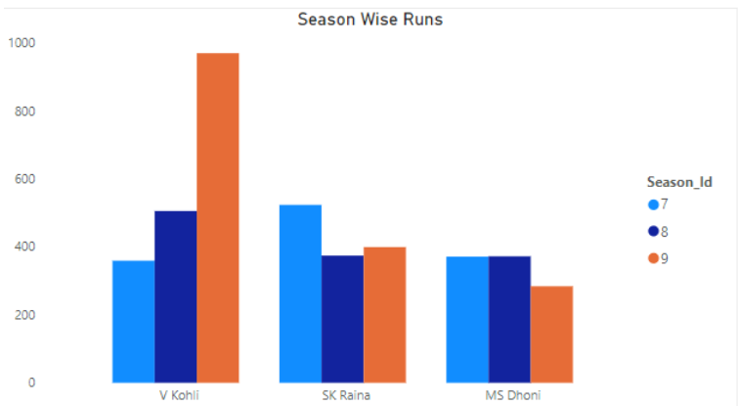
Analysis & Insights
Now we will see performance of 3 players in last 3 seasons to check their consistency.

Slide 11
Analysis & Insights
From the visualisation on the last page , we can clearly observe two things.
First, Virat Kohli’s performance has increase at a staggering rate in the last 3 seasons.
While the performance of both MS Dhoni and Suresh Raina ahs decreased in the last 3 seasons.

Slide 12
Analysis & Insights
Now we will see 2 important factors which are majorly responsible for RCB not wining any trophy.
The 2 major factors are:- a) Total runs scored and wickets taken by RCB in previous seasons and b) Averages of batting position 5,6,7

Slide 13
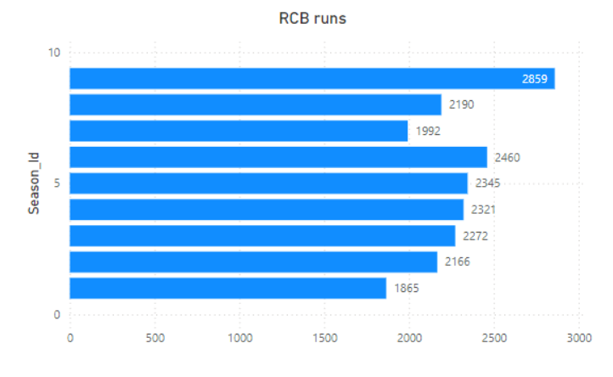
Runs scored by RCB in different seasons
Most runs were scored by RCB in last season (season 9) which were 2859.
Runs scored by RCB show an increasing trend except for season 7 where there is a decline of almost 500 runs.

Slide 14
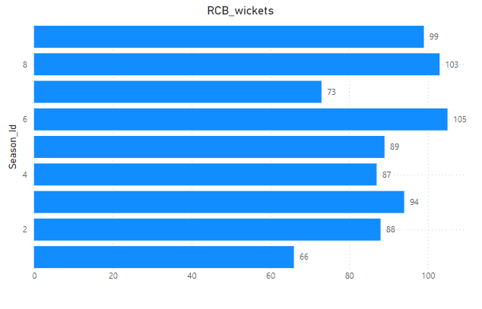
Wickets taken by RCB in different seasons
Most wickets were taken by RCB in seaon 6 which were 105.
Wickets taken by RCB shows their inconsistent bowling performance over the years.
This is one of the main reasons of not winning them any trophy.

Slide 15
Analysis & Insights
We can clearly see that RCB scored most runs in 2016 (season 9) ,which is also the season where RCB reached final.
They also took close to 100 wickets in 2016.
Also the 2 seasons (1 and 7) where RCB scored less than 2000 runs and took less than 80 wickets, are the seasons in which they ended up in bottom 4 of the table.
So we can conclude that RCB did not win trophy because of their inconsistent performance.

Slide 16
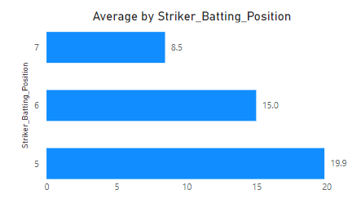
Averages of batting position 5,6,7
There is no one in the lower middle order to bail them out when the top order fails.
Too much dependency on top order and unavailability of proper finishers and all rounders is one of the main reason of RCB not winning any trophy.

Slide 17
Strategic Recommendations before going to Auction
Targeting good lower order batters (5,6,7) for better performance in death overs.
Targeting bowlers which can produce swing and seam with the all in powerplay and gives the early breakthrough.
Focussing on spinners which can control the pace of the game in middle overs and take wickets at regular intervals.

Slide 18
Strategic Recommendations before going to Auction
Focussing on bowlers which can produce different variations in death overs like yorker,knucle ball, cutter etc.
Targeting fitter players to improve fielding as we know “Catches Win Matches”.
Building a base around young talent with the existing senior base of players guiding them.

Slide 19
Conclusion
RCB is inconsistent with their performance.
They do not perform together as a unit , sometime they do good with bat and sometimes with ball , but not together.
RCB needs to target more young players , economical death bowlers , power hitters.
RCB needs to work on their lower middle order.
By foolowing these strategies, RCB can improve their performane.

